Slide 1
Forward modelling figs
MNE - github

Slide 2
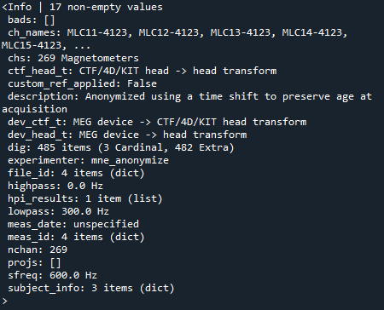

Slide 3


Subject MRI
fsaverage

Slide 4
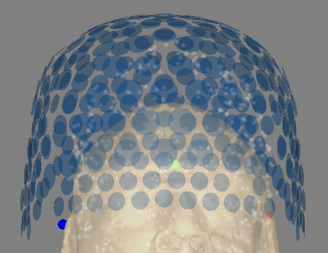
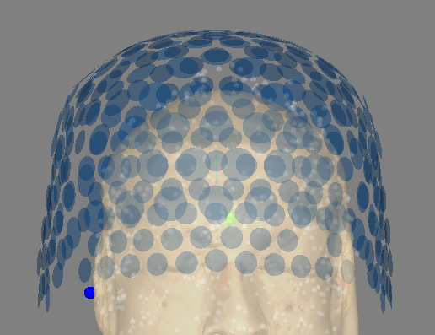
Original
Co-registered

Slide 5
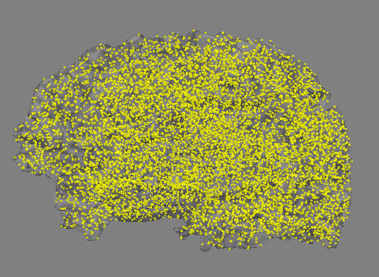
Oct6

